Slide 1
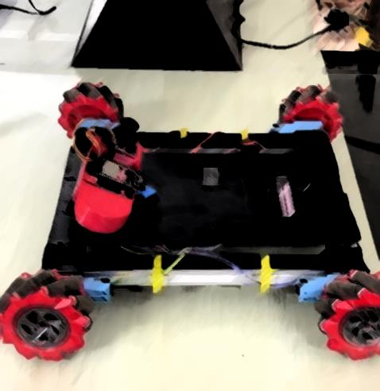

DESIGN AND IMPLEMENTATION OF MECCANUM WHEEL REMOTE CONTROLLED VEHICLES USING ESP32 AND PEER TO PEER WIFI COMMUNICATION
4th year Project

Slide 2
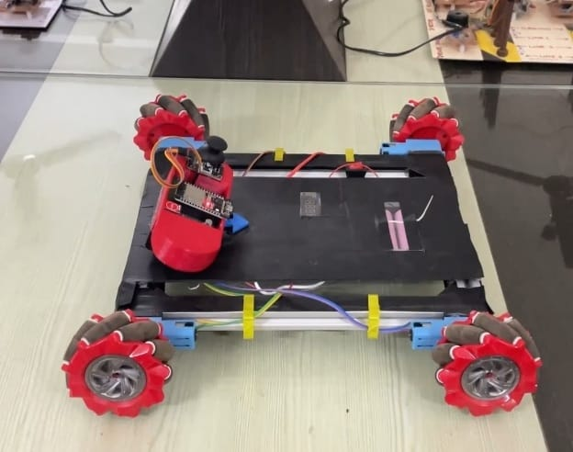
Meet Our Team
20MH1A4923 - K.V.S.Karthik
21MH5A4916 - D .Kasi Viswanadh
21MH5A4909 - Palak Raj Mishra
20MH1A4912 - D .Vijay Sankar
20MH1A4946 - V.V.V.Pavan Aditya
Under the guidance of :
Dr . B. Kiran Kumar(PhD)
Professor,
Department of CSE(IOT & AIML),
Aditya College of Engineering

Slide 3
CONTENT
Abstract
1
2
Introduction
Block Diagram
3
4
Hardware components
Software components
5
6
Modes
Advantages
7
8
Disadvantages
Applications
9
10
Result
11
Conclusion

Slide 4
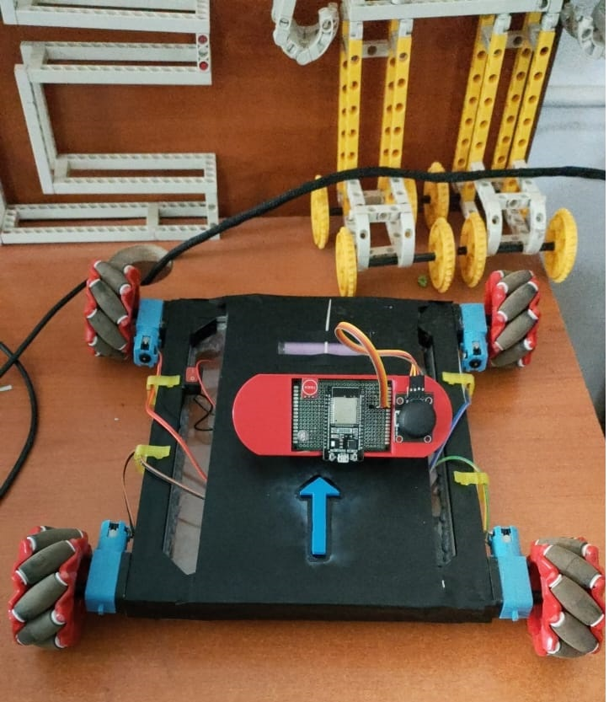
ABSTRACT
This research explores the cutting-edge design and implementation of mecanum wheel-equipped remote-controlled vehicles, harnessing the capabilities of the ESP32 microcontroller and establishing seamless communication through peer-to-peer Wi-Fi networks. Mecanum wheels, known for their omnidirectional movement, provide enhanced maneuverability. The ESP32 microcontroller acts as the central processing unit, orchestrating precise control of each mecanum wheel for unparalleled agility.

Slide 5
INTRODUCTION
Our project centers around a remote-controlled vehicle equipped with mecanum wheels. Mecanum wheels provide unparalleled agility and omnidirectional movement, making our vehicle highly maneuverable in any direction.
Key Components:
Mecanum Wheels: These special wheels allow for precise and smooth movements in any direction.
ESP32 Microcontroller: The brains of our project, the ESP32, provides powerful processing and built-in Wi-Fi capabilities.
Remote Control Unit: A user-friendly interface for sending commands wirelessly to control the vehicle.
P2P Wi-Fi Communication: Our vehicle uses peer-to-peer Wi-Fi communication, enabling direct connectivity between the remote and the vehicle.

Slide 6
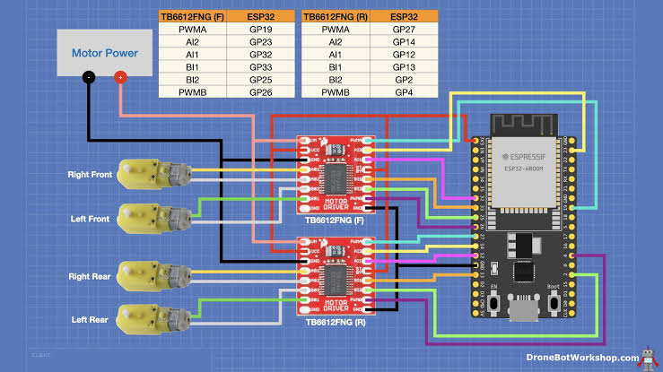
BLOCK DIAGRAM
MECCANUM WHEEL VEHICLE:
Here we used ESP32, FNG Motor, Meccanum Wheel,
Buck Converter, Gear Motor, Switch, Battery and Jump wires in which dump the code by using software,
and connect through wires and design in it.
2 FNG Motors
ESP32
4 Gear Motors
Buck Converter
Switch
Wires
Power Supply
Battery

Slide 7
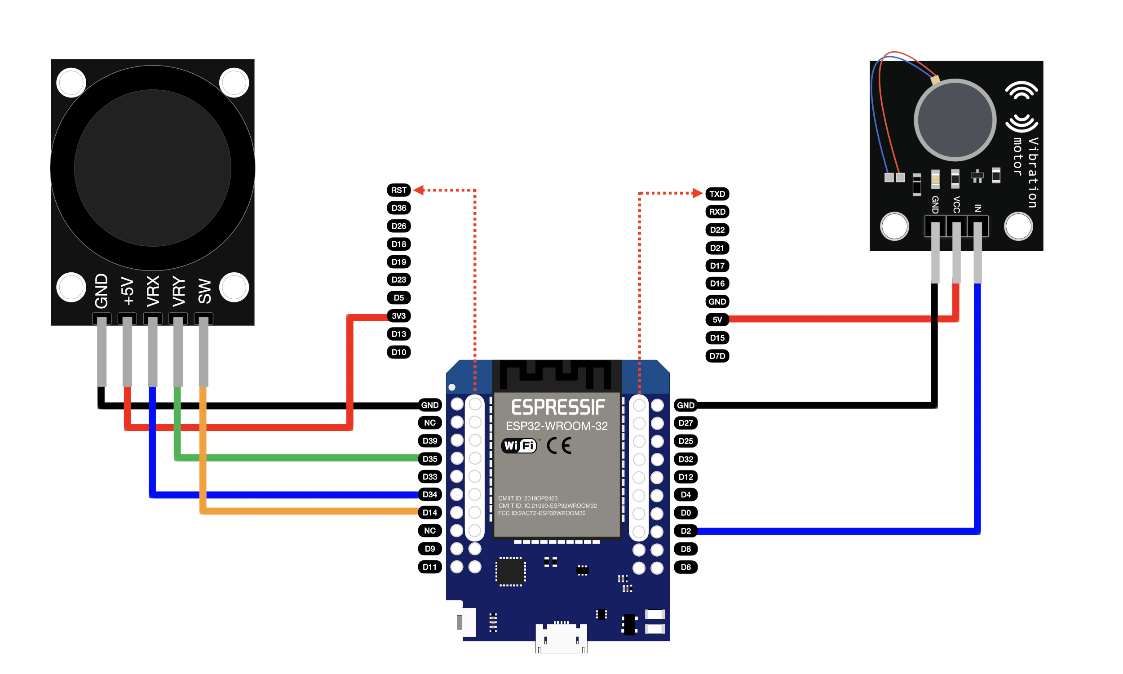
BLOCK DIAGRAM
REMOTE CONTROLLER:
Here we used ESP32, Power Adaptor, Touch Sensor,
Battery, LED Bulb, Jump Wires, PCB board prototype,
Joystick by using wi-fi peer to peer communication in it.
LED Bulb
ESP32
Touch Sensor
Power Adaptor
Jump Wires
Joystick
Battery

Slide 8
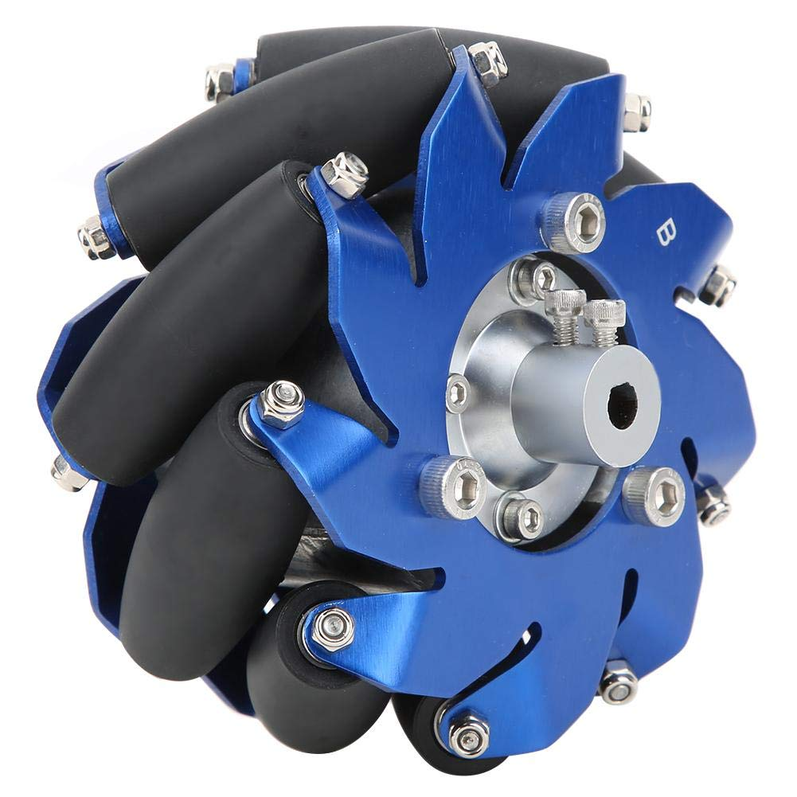
HARDWARE COMPONENTS
MECCANUM WHEEL:
Mecanum wheels are a type of omnidirectional wheel designed for advanced maneuverability in robotics applications. These wheels enable a vehicle to move in any direction and rotate about its own axis with exceptional ease. Mecanum wheels consist of a central hub with rollers mounted at an angle to the axis of rotation, typically at a 45-degree angle.

Slide 9
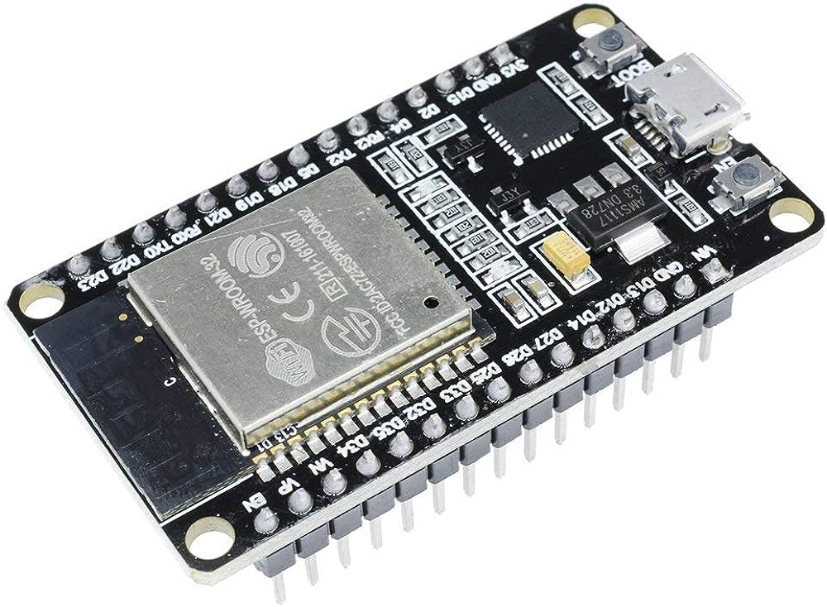
HARDWARE COMPONENTS
ESP32:
The ESP32 is a versatile and widely used microcontroller that integrates Wi-Fi and Bluetooth capabilities. It is part of the ESP family of microcontrollers. The ESP32 is particularly known for its low power consumption, high processing power, and extensive connectivity options.

Slide 10
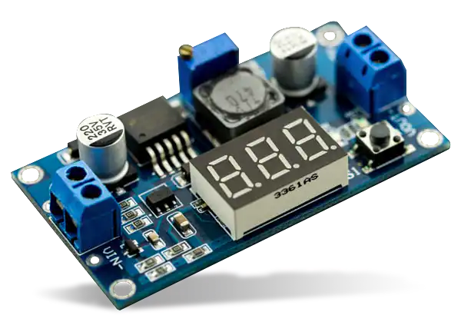
HARDWARE COMPONENTS
BUCK CONVETER:
A buck converter, also known as a step-down converter, is a type of DC-DC power converter that transforms a higher DC voltage to a lower DC voltage. This conversion is achieved through the use of inductors, capacitors, and semiconductor switches (typically transistors). Buck converters are widely used in electronic devices and power supply systems to efficiently regulate voltage levels.

Slide 11
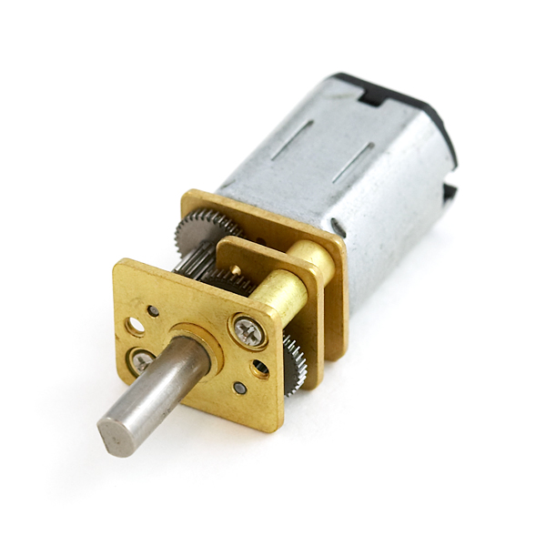
HARDWARE COMPONENTS
GEAR MOTOR:
A gear motor is an all-in-one combination of a motor and gearbox. The addition of a gearbox to a motor reduces the speed while increasing the torque output. The most important parameters in regard to gear motors are speed (rpm), torque and efficiency (%). In order to select the most suitable assembly for your application, you must first compute the load, speed and torque requirements for your application.

Slide 12
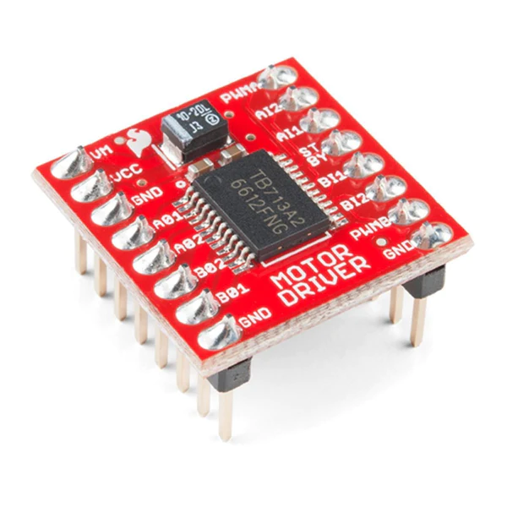
HARDWARE COMPONENTS
FNG MOTOR DRIVER:
Controlling the speed and direction of DC motors is very important due to their many applications. The most common method of controlling DC motors is the H-Bridge. This method allows you to control both the speed and the direction of the engine. The TB6612FNG dual module uses the same method to control two motors.
One of the control pins of this module is PWM. This pin is connected to the gate of the transistor. The longer the duty cycle, the higher the voltage and, as a result, the faster the motor rotates.
The motor working voltage is in the range of 2.7 to 13.5V and the maximum output current is up to 1.2 A per channel.

Slide 13
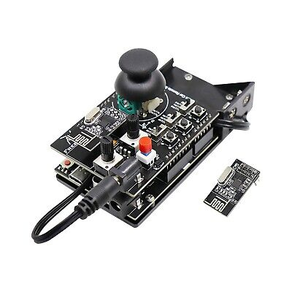
HARDWARE COMPONENTS
REMOTE CONTROLLER:
A remote controller, also known as a remote control or simply a remote, is a device used to operate electronic devices wirelessly from a distance. It typically uses infrared (IR) signals, radio frequency (RF) signals, Bluetooth, or other wireless communication technologies to transmit commands from the remote to the target device. Remote controllers are widely used in various consumer electronics, home automation systems, and industrial applications.

Slide 14
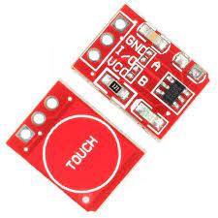
HARDWARE COMPONENTS
TOUCH SENSOR:
An on board LED will give a visual indication of when the sensor is triggered. When triggered the output of the module will switch from its idle low state to high (default operation). Solder jumpers allow for reconfiguring its mode of operation to be either active low or toggle output.
An on board LED will give a visual indication of when the sensor is triggered. When triggered the output of the module will switch from its idle low state to high (default operation). Solder jumpers allow for reconfiguring its mode of operation to be either active low or toggle output.
TTP223 Capacitive Touch Sensor Module. The TTP223 is a touchpad detector IC replicating a single tactile button.

Slide 15
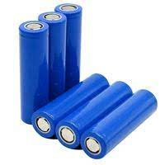
HARDWARE COMPONENTS
BATTERY:
Battery is a part of a circuit that provides the electricity. Battery can be said as the source to provide electricity to the circuit. So its main function is to supply electric power in order for electric items to work
A battery is a device consisting of one or more electro chemical cells with external connection provided to power electric device. A battery have a positive terminal or anode and a negative terminal or cathode. The terminal marked positive is at a higher electrical potential energy then is the terminal marks negative terminal have electron that is flow external circuit and deliver energy here for battery are connected in series and it is use to power supply to DC motor, than motor is make forward and backward to wheel.

Slide 16
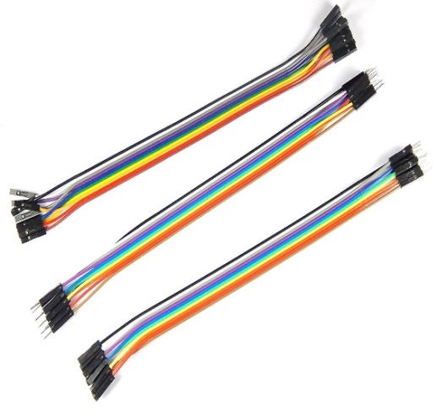
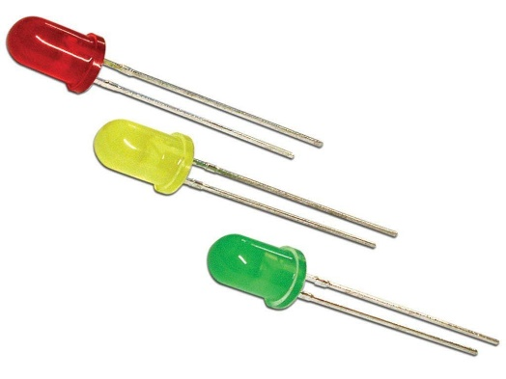
HARDWARE COMPONENTS
JUMP WIRES:
Connecting wire is a piece of wire used to attach two circuits or components together. The gauge or the size of the wire must be large enough to support the amount of current flow. Wires are used to join parts of a circuit. Electricity flows through wires
LED BULB:
An LED bulb, also known as a light-emitting diode bulb, is a type of light bulb that uses light-emitting diodes (LEDs) as the source of illumination. LED bulbs are highly efficient, long-lasting, and environmentally friendly alternatives to traditional incandescent and compact fluorescent bulbs.

Slide 17
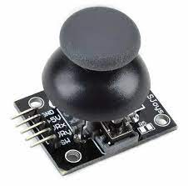
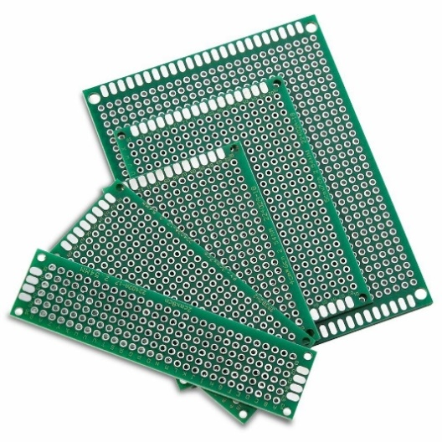
HARDWARE COMPONENTS
JOYSTICK:
A joystick is a type of input device used primarily in electronic systems, such as computers, gaming consoles, remote-controlled vehicles, and industrial control systems, to control the movement of an on-screen cursor, character, or other graphical elements. It typically consists of a handheld lever or stick that can be tilted or moved in various directions, along with one or more buttons or triggers for additional functions.
PCB Board Prototype BreadBoard:
A breadboard, also known as a protoboard or solderless breadboard, is a device used for prototyping and testing electronic circuits. It provides a platform for temporarily connecting electronic components and wires without the need for soldering, allowing for quick and easy experimentation and modification of circuit designs

Slide 18
SOFTWARE COMPONENTS
PEER-TO-PEER (P2P) WI-FI COMMUNICATION:
Peer-to-peer (P2P) Wi-Fi communication refers to the direct wireless communication between two or more devices without the need for a traditional network infrastructure or a centralized access point. In a P2P Wi-Fi setup, devices can connect and communicate with each other directly, forming a decentralized network. This type of communication is also commonly known as Wi-Fi Direct.
Direct Device-to-Device Communication:
Wi-Fi Direct Standard:
Operating Modes:
Discoverability:
Authentication and Pairing:
Cross-Platform Compatibility:
Connection Management:
Power Management:
API Support:
Group Communication:

Slide 19
SOFTWARE COMPONENTS
ESP32 Development Environment:
Set up the ESP32 development environment using a platform like Arduino IDE or Platform IO.
Motor Control:
Develop motor control algorithms to drive the mecanum wheels based on the control signals received over Wi-Fi.
Mecanum Wheel Kinematics:
Implement mecanum wheel kinematics to calculate the individual wheel speeds based on the desired robot motion. This is crucial for achieving the desired movement characteristics of a mecanum wheel robot.
User Interface:
Develop a user interface for remote control. This could be a mobile application, a web-based interface, or a physical remote control device. Ensure it can send control commands to the robot over the Wi-Fi network.
Control Commands:
Define a protocol for sending control commands from the remote control to the robot. This protocol could include commands for forward, backward, sideways, and rotational movements.

Slide 20
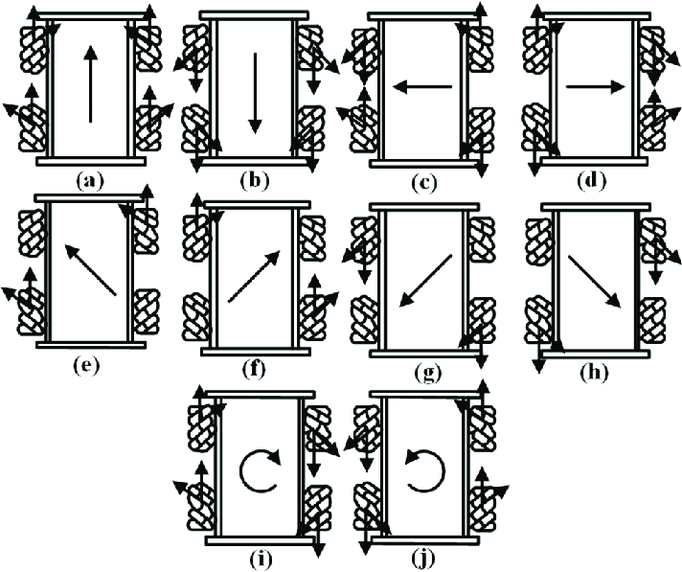
MODES
1.Basic Movement Commands:
Move Forward
Move Backward
Move Left
Move Right
2. Rotation Commands:
Rotate Clockwise:
Rotate Counterclockwise
3. Diagonal Movement Commands:
Move Diagonally Forward and Left:
Move Diagonally Forward and Right:
Move Diagonally Backward and Left:
Move Diagonally Backward and Right

Slide 21
ADVANTAGES
The Mecanum wheel, also known as the Swedish wheel or Ilion wheel, is a unique type of wheel designed to provide omnidirectional movement and maneuverability in various applications. Here are some advantages of Mecanum wheels:
Omnidirectional Movement: Mecanum wheels are designed with special rollers set at an angle around the circumference of the wheel. This arrangement allows the wheel to move in any direction without changing its orientation, providing omnidirectional movement. This capability is particularly useful in robotics and material handling applications where precise maneuverability is required.
Smooth and Agile Movement: Mecanum wheels provide smooth and agile movement, making them ideal for applications that require precise control and maneuverability in confined spaces. They can move laterally, diagonally, and rotate seamlessly, allowing for efficient navigation around obstacles and tight spaces.
Simple Control System: Mecanum wheels are relatively easy to control compared to other omnidirectional wheel designs. They can be controlled using a standard differential drive system with individual motors for each wheel. By varying the speed and direction of rotation of each wheel, complex movements and trajectories can be achieved with minimal programming effort.

Slide 22
ADVANTAGES
Versatility: Mecanum wheels can be used in a wide range of applications, including mobile robots, automated guided vehicles (AGVs), material handling systems, and even certain types of vehicles. Their versatility makes them suitable for various industries such as manufacturing, logistics, warehousing, and research.
Reduced Wear and Tear: Mecanum wheels are designed to distribute the load evenly across multiple rollers, reducing wear and tear on the wheel and the surface it moves on. This design feature helps prolong the lifespan of the wheels and ensures smooth operation over extended periods.
Adaptability to Uneven Surfaces: Mecanum wheels can adapt to uneven surfaces to some extent due to their unique roller arrangement. While they may not be as effective on extremely rough terrain as specialized off-road wheels, they can navigate moderate obstacles and irregular surfaces with relative ease, making them suitable for indoor and outdoor applications.
Compact Design: Mecanum wheels have a compact and lightweight design compared to some other omnidirectional wheel configurations. This compactness allows for easy integration into small robots and vehicles without significantly increasing the overall size or weight.

Slide 23
DISADVANTAGES
While Mecanum wheels offer various advantages, they also come with some limitations and disadvantages. Here are some of the disadvantages of Mecanum wheels:
Reduced Load Capacity: Mecanum wheels typically have a lower load capacity compared to traditional wheels, especially when used in heavy-duty applications. The arrangement of rollers and the wheel's design may not be as robust as solid wheels, limiting the maximum weight that can be supported.
Limited Traction: Mecanum wheels rely on the friction between the rollers and the ground to generate movement. However, this design can result in limited traction, especially on slippery or uneven surfaces. As a result, Mecanum wheels may struggle to maintain traction in certain conditions, affecting their performance.
Higher Energy Consumption: The omnidirectional movement capability of Mecanum wheels often requires complex control algorithms and individual motor control for each wheel. This increased complexity can lead to higher energy consumption compared to traditional wheel configurations, especially in robotic applications where energy efficiency is crucial.

Slide 24
DISADVANTAGES
Reduced Efficiency on Rough Terrain: While Mecanum wheels can adapt to some degree on uneven surfaces, they may not perform as effectively on rough terrain compared to specialized off-road wheels. The rollers' design may struggle to maintain contact with the ground on extremely uneven or rough surfaces, leading to reduced efficiency and potential damage to the wheels.
Complex Control System: Achieving precise control and coordination of Mecanum wheels requires a sophisticated control system. Programming the motion algorithms and coordinating the movement of multiple wheels can be complex and time-consuming, requiring advanced knowledge of robotics and control theory.
Higher Cost: Mecanum wheels tend to be more expensive than traditional wheels due to their specialized design and the additional complexity involved in manufacturing and control. The cost of individual Mecanum wheels, as well as the associated control systems and components, can add up, making them a less cost-effective option in some applications.
Maintenance Requirements: The intricate design of Mecanum wheels, particularly the individual rollers, may require more frequent maintenance compared to traditional wheels. The rollers can be susceptible to damage from debris or excessive wear over time, necessitating regular inspection and replacement to maintain optimal performance.

Slide 25
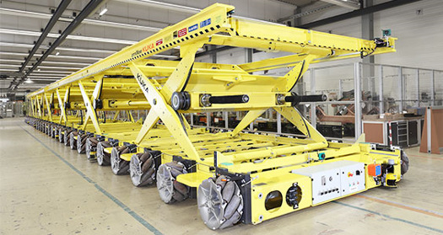
APPLICATIONS
Meccanum wheels are versatile and find applications in various fields where omnidirectional movement is desired. Some common applications of mecanum wheels include:
Mobile Robotics:
Mecanum wheels are widely used in mobile robots and unmanned ground vehicles (UGVs) to achieve omnidirectional movement capabilities. They enable robots to move in any direction without changing their orientation, making them suitable for navigation in tight spaces, crowded environments, and complex terrains.
Industrial Automation:
Mecanum wheels are integrated into industrial automation systems and machinery to facilitate flexible and agile movement of robotic arms, manipulators, and assembly platforms. They enable precise positioning and manipulation of work pieces in manufacturing processes, assembly lines, and production facilities.

Slide 26
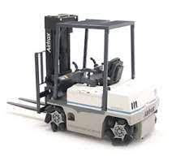
APPLICATIONS
Material Handling Systems:
Mecanum wheels are utilized in material handling systems, such as conveyor belts, automated guided vehicles (AGVs), and warehouse robots, to transport goods and materials with precise control and maneuverability. They allow for efficient movement and sorting of items in logistics and distribution centres.
Research and Development:
Mecanum wheels are employed in research and development projects, robotics competitions, and academic laboratories for prototyping, testing, and experimenting with omnidirectional motion control algorithms, navigation systems, and robotic platforms.
Agricultural Robotics:
Mecanum wheels are integrated into agricultural robots and automated farming equipment for tasks such as crop monitoring, precision spraying, and autonomous harvesting. They allow robots to navigate through fields and orchards with ease, optimizing efficiency and productivity in agricultural operations.

Slide 27
RESULT

Slide 28
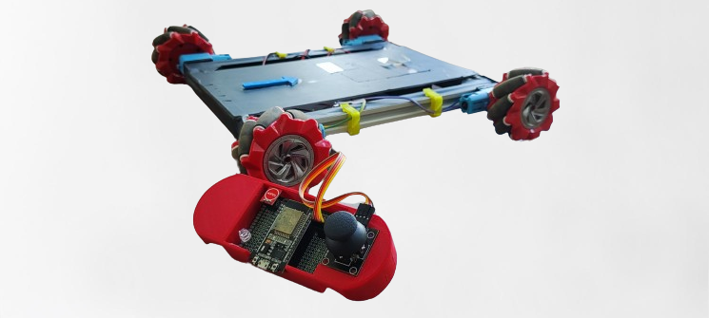
RESULT
The study delves into hardware intricacies, including mecanum wheel assembly, motor control interfaces, and sensor integration. A peer-to-peer Wi-Fi communication protocol is implemented, facilitating efficient data exchange between the remote control unit and the vehicle, enhancing reliability and range. Experimental results highlight dynamic maneuverability and responsiveness, showcasing the system's suitability for applications like surveillance, exploration, and entertainment. This research contributes to mecanum wheel robotics by introducing an innovative approach, leveraging ESP32 microcontrollers and peer-to-peer Wi-Fi communication, opening possibilities for agile and versatile remote-controlled vehicles across diverse domains from industrial automation to educational platforms.
Video Link

Slide 29
CONCLUSION:
Advancements in Robotics: Mecanum wheels are expected to play a crucial role in the evolution of robotic systems. Their ability to move in any direction with precision opens up new possibilities for applications in industries such as manufacturing, healthcare, and logistics.
Autonomous Vehicles: The versatility of mecanum wheels makes them a compelling choice for autonomous vehicles. Future developments may see mecanum-equipped drones, unmanned ground vehicles, and even urban mobility solutions that leverage the unique capabilities of these wheels for efficient and agile navigation.
Integration with AI and Machine Learning : Mecanum wheels, when combined with advancements in artificial intelligence and machine learning, can lead to robots that adapt and learn from their environments. Smart navigation algorithms and decision-making processes could enhance the autonomy and efficiency of mecanum-equipped systems.
Precision Agriculture and Exploration : In agriculture, mecanum wheels could find applications in autonomous farming equipment, providing precise and flexible navigation through fields. Similarly, exploration missions in challenging terrains on Earth or other planets could benefit from the omnidirectional mobility of mecanum wheels.
Human-Robot Collaboration : The safety and agility of mecanum wheels make them well-suited for environments where close collaboration between humans and robots is essential. Future developments may focus on enhancing the ability of mecanum-equipped robots to work alongside humans in shared spaces.

Slide 30
THANK YOU

